Slide 1

SELL RECOMMENDATION 19% Downside

Slide 2


Company Description

Slide 3

About Houlihan Lokey
INVESTMENT BANKING COMPANY
Global independent investment bank
Provides services in mergers and acquisitions (M&A), capital markets, financial restructurings, and financial and valuation advisory
#1 Most active global M&A advisor following the acquisition of GCA Corp

Slide 4
Operating Structure
Mixed client base
Three segments of operation

Slide 5

Strengths

Slide 6
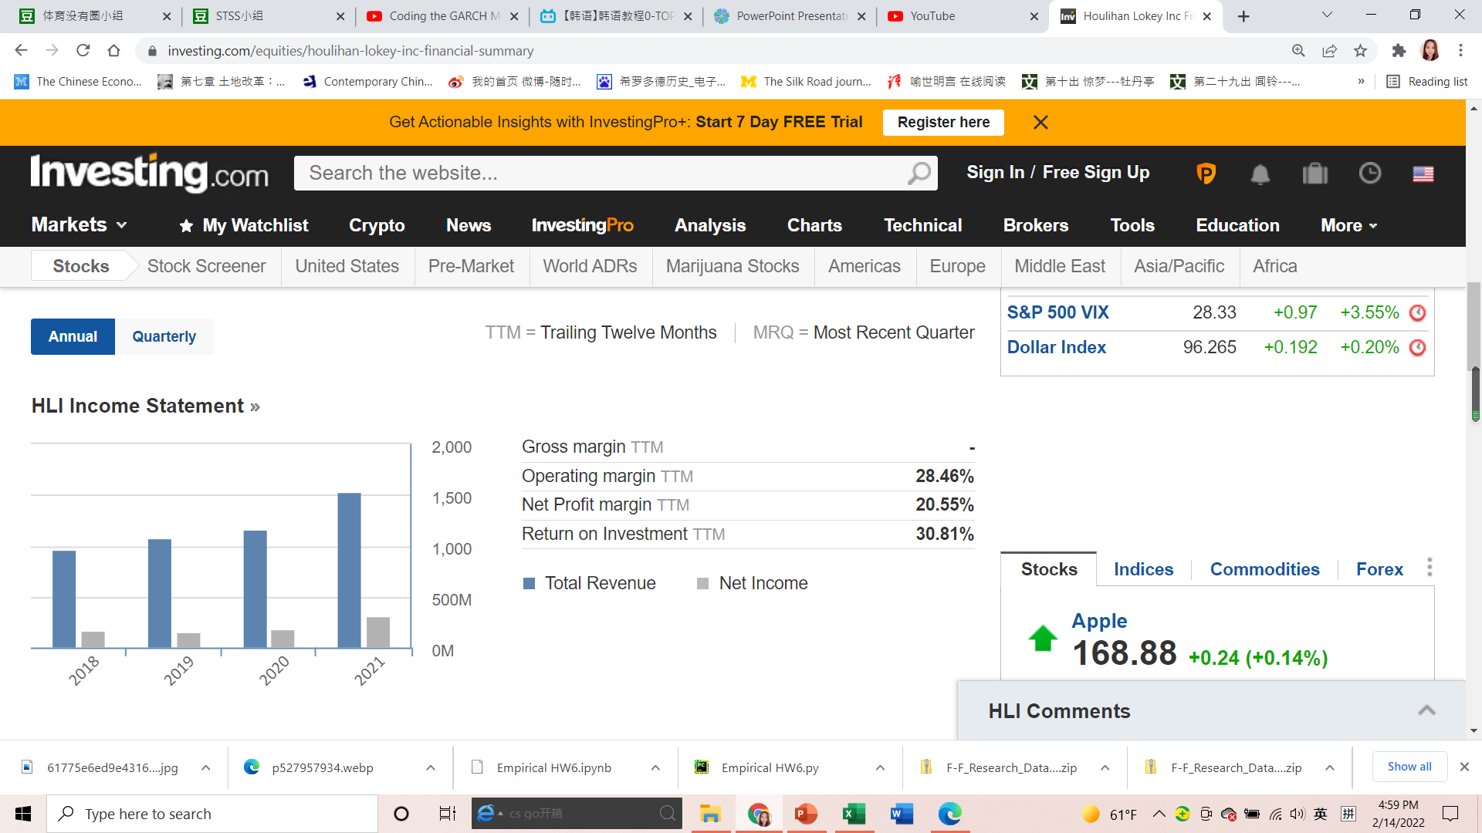
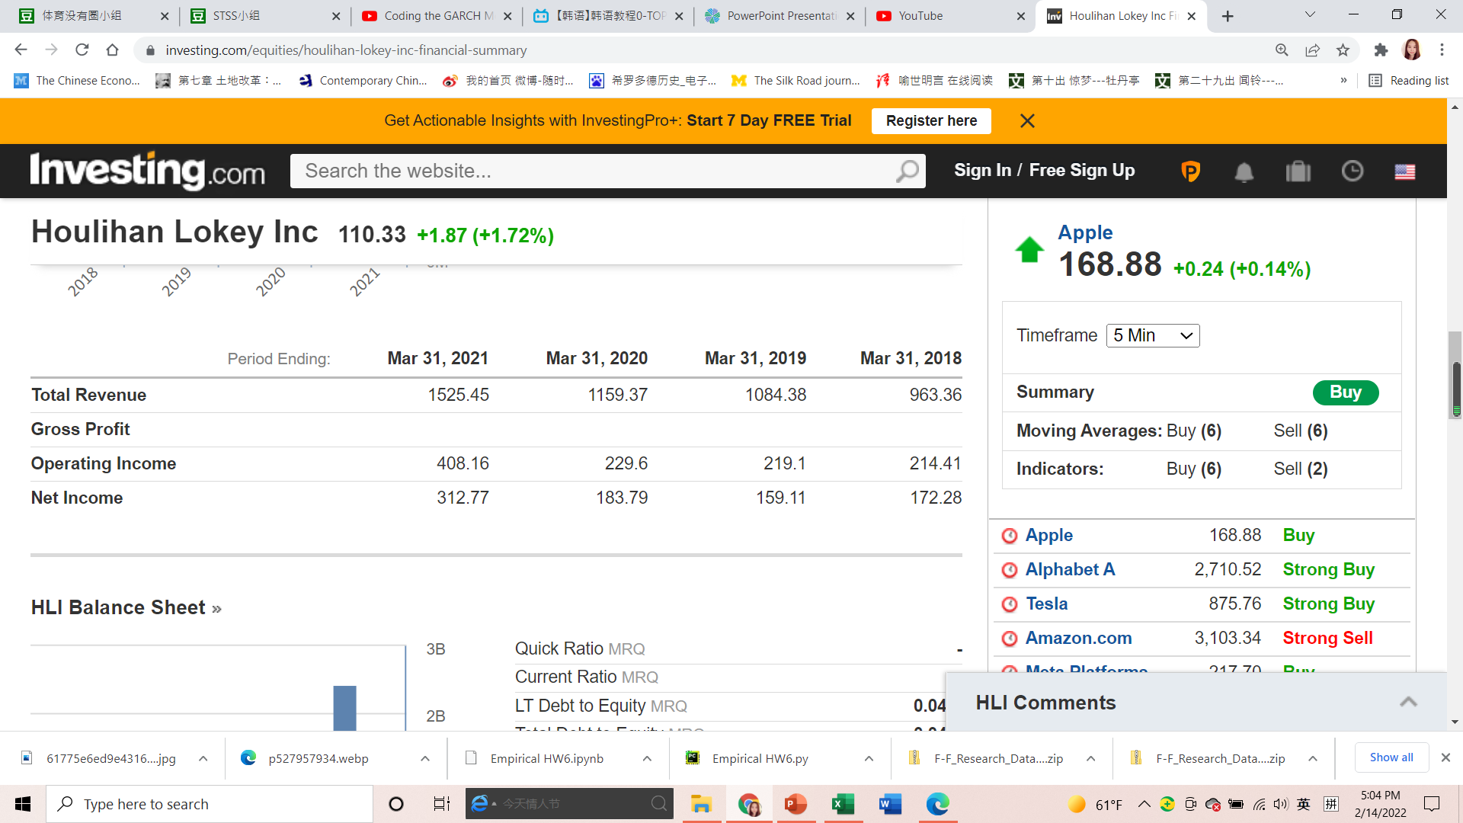
Profitability and Capital Efficiency
September 30th 2021
Revenue 537M
Profit Margin Ratio 21.39%
Efficiency Ratio 70.88%
Quarterly ROCE 38.53%
Return on Asset 20.04%
Return on Equity 32%

Slide 7
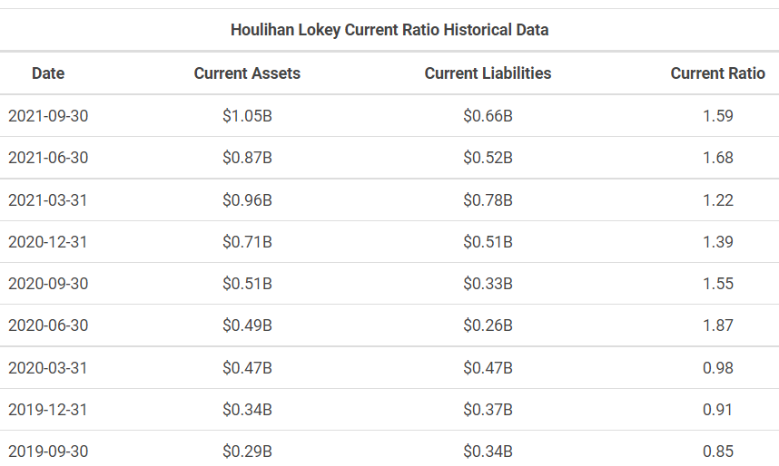
Leverage and Financial Strength

Slide 8
COVID Response

Slide 9
Weaknesses

Slide 10
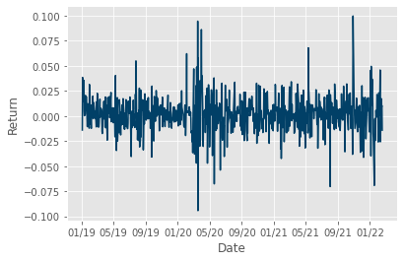
Volatile Earnings

Slide 11

A Controlled Company
1 votes/share
23.2%
10 votes/share
76.8%

Slide 12
Goodwill Impairment

Slide 13
Valuation

Slide 14
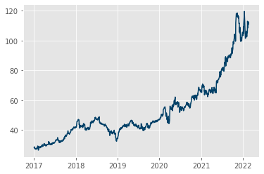
Target Price
• Dividend Discount Model [10%]
• Excess Return Discount Model [30%]
• P/B multiplier model [60%]
93

Slide 15
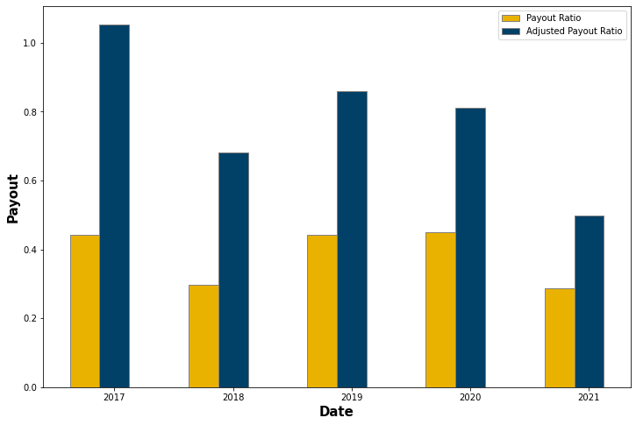
Cash Flow Discounting

Slide 16
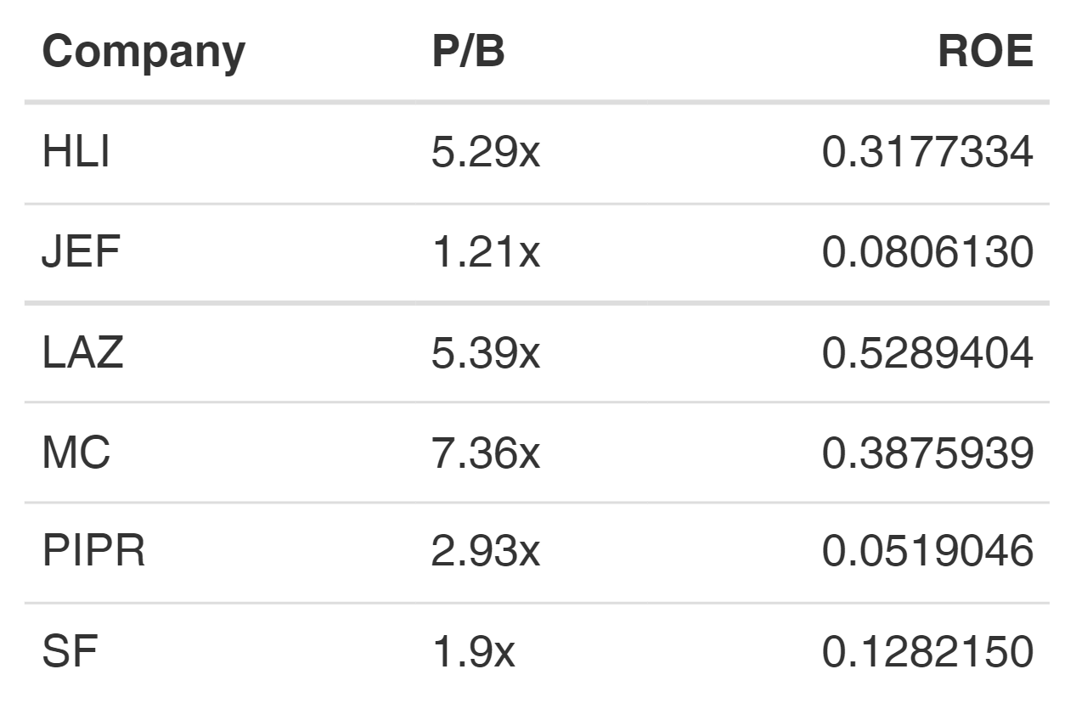
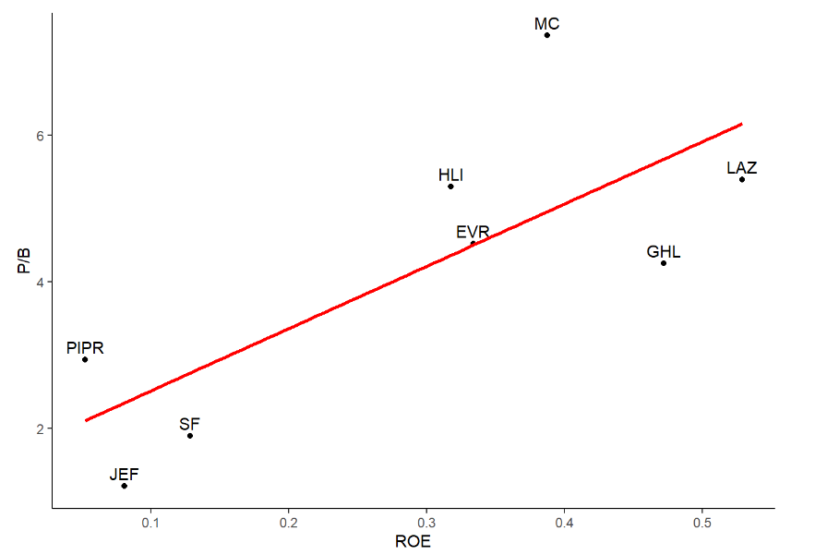
Relative Valuation

Slide 17
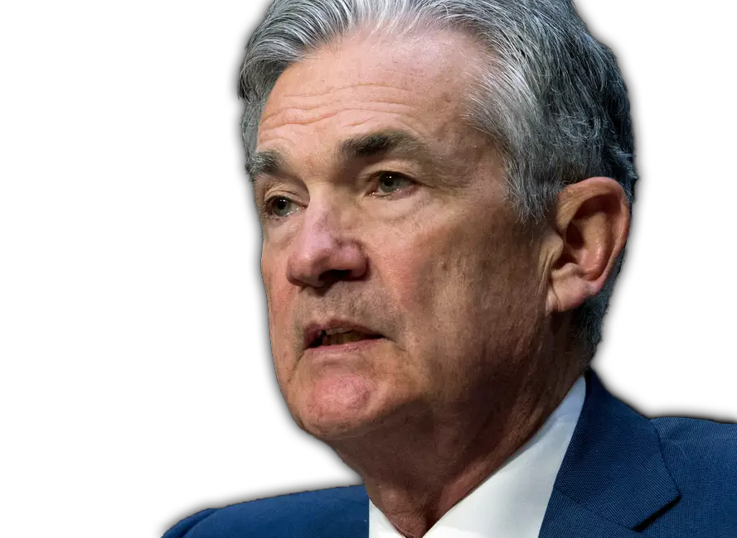
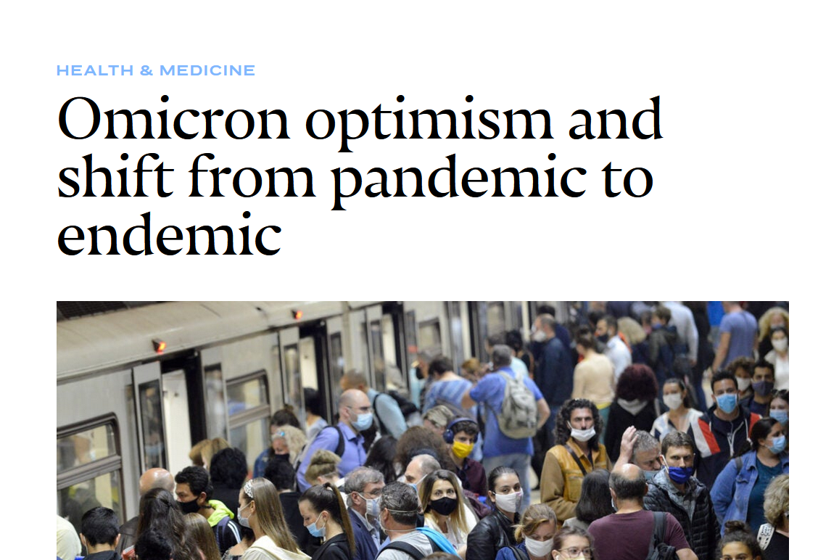
Looking Forward

Slide 18

Recommendation
VS
$114.96
$92.95
Estimated Stock Price
Actual Stock Price

Slide 19
Appendix

Slide 20
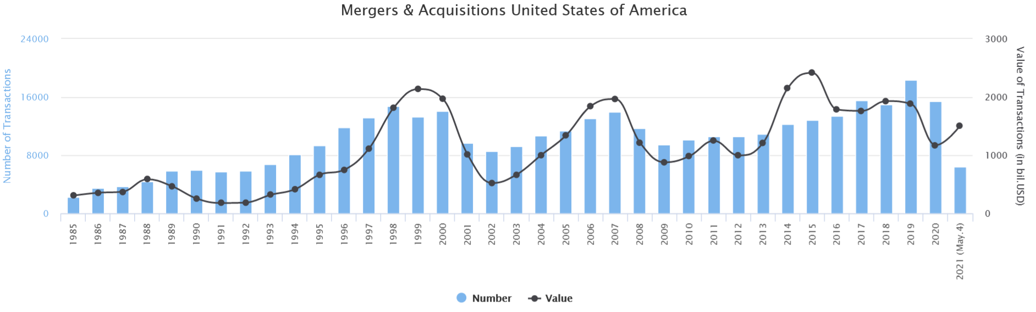
M&A Waves 1

Slide 21
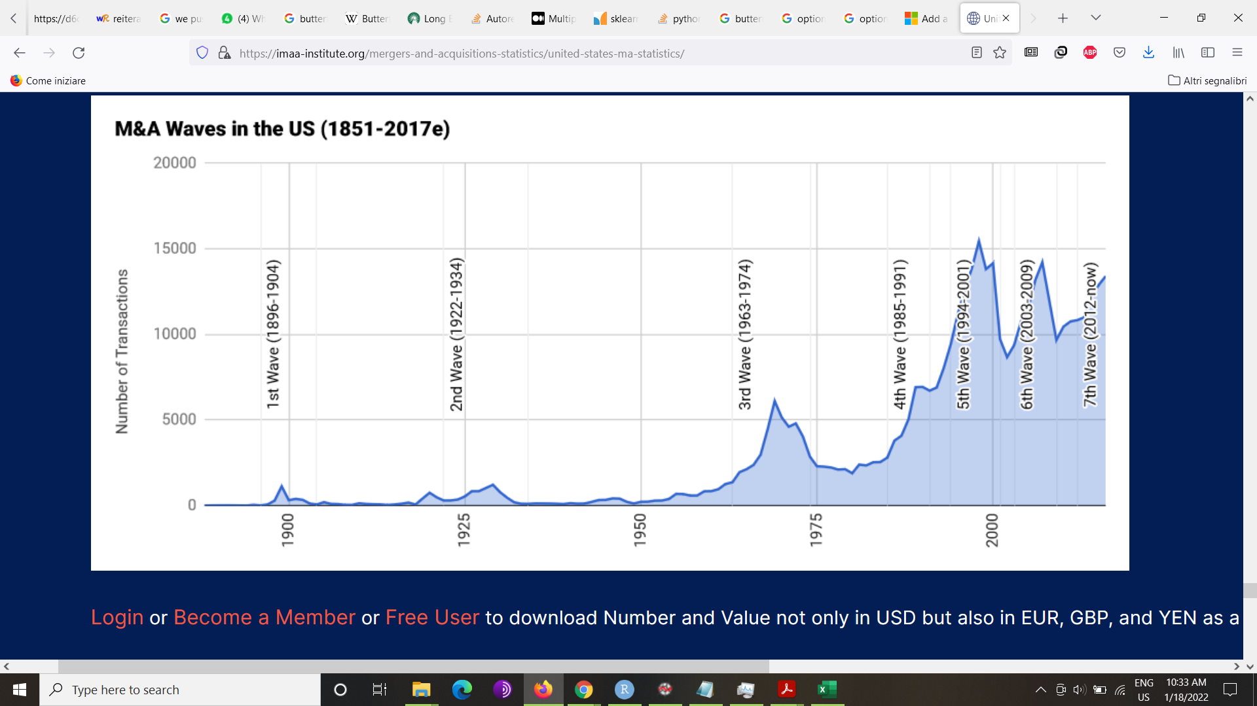
M&A Waves 2

Slide 22
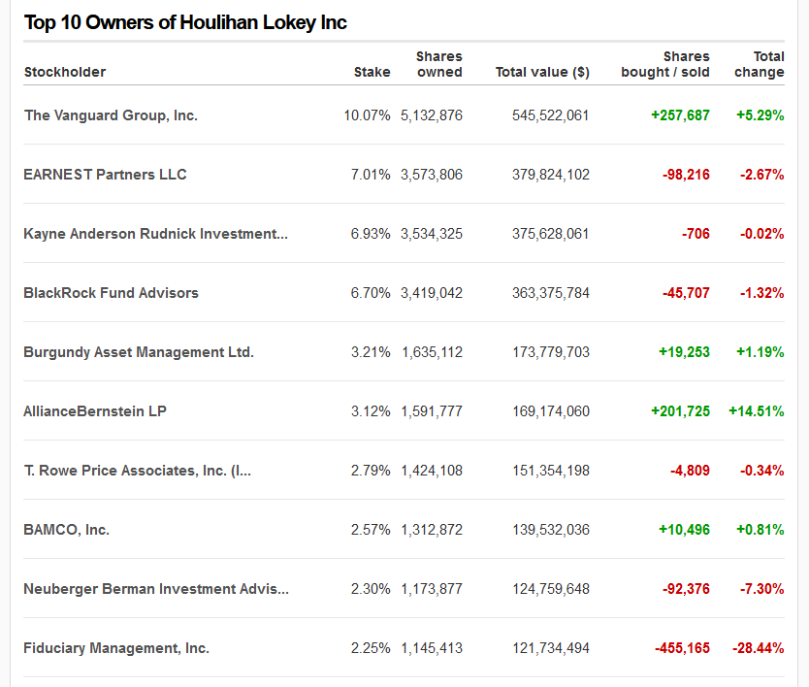

Slide 23
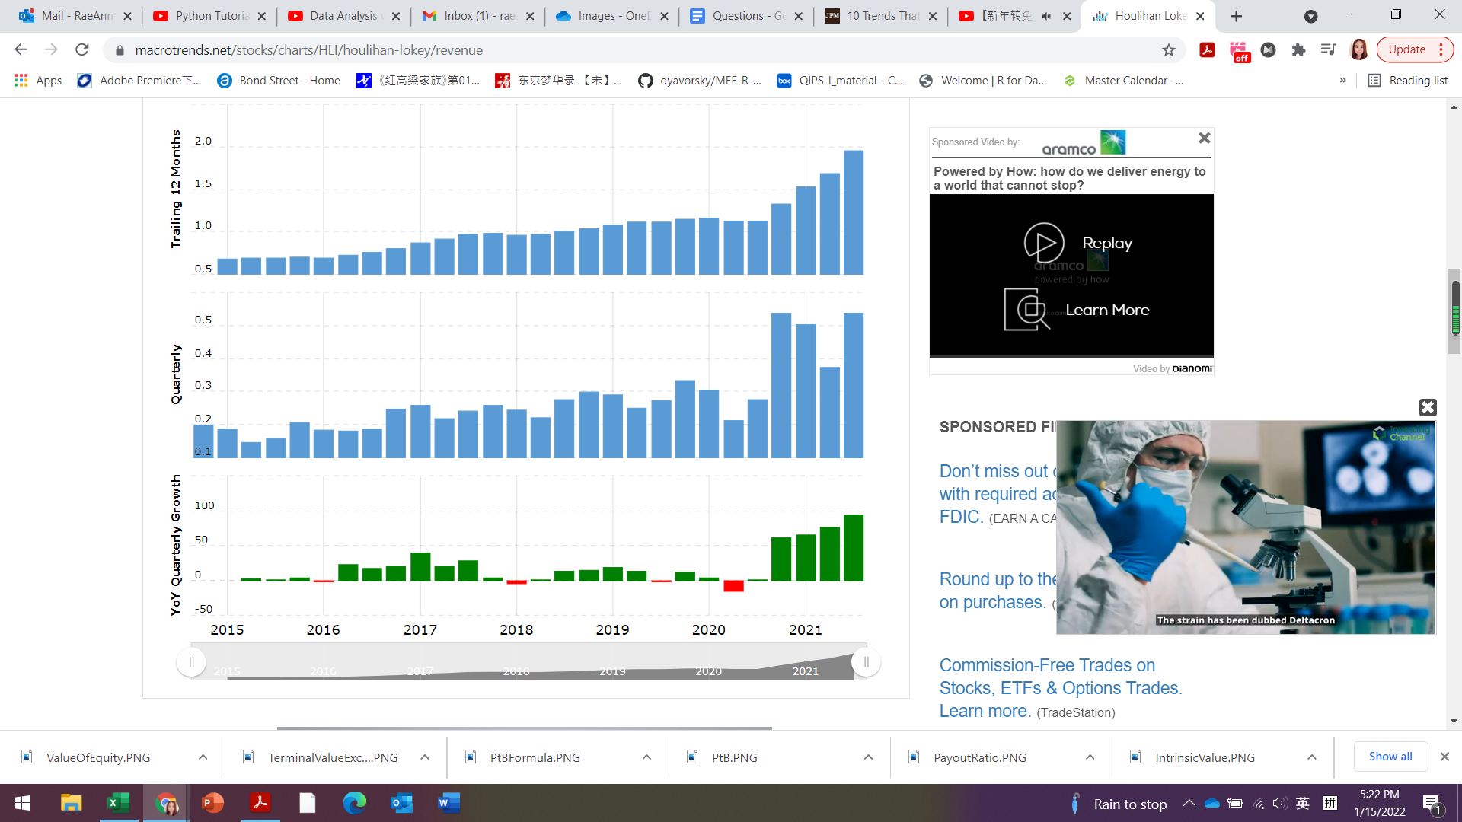
Quarterly Growth over the years

Slide 24
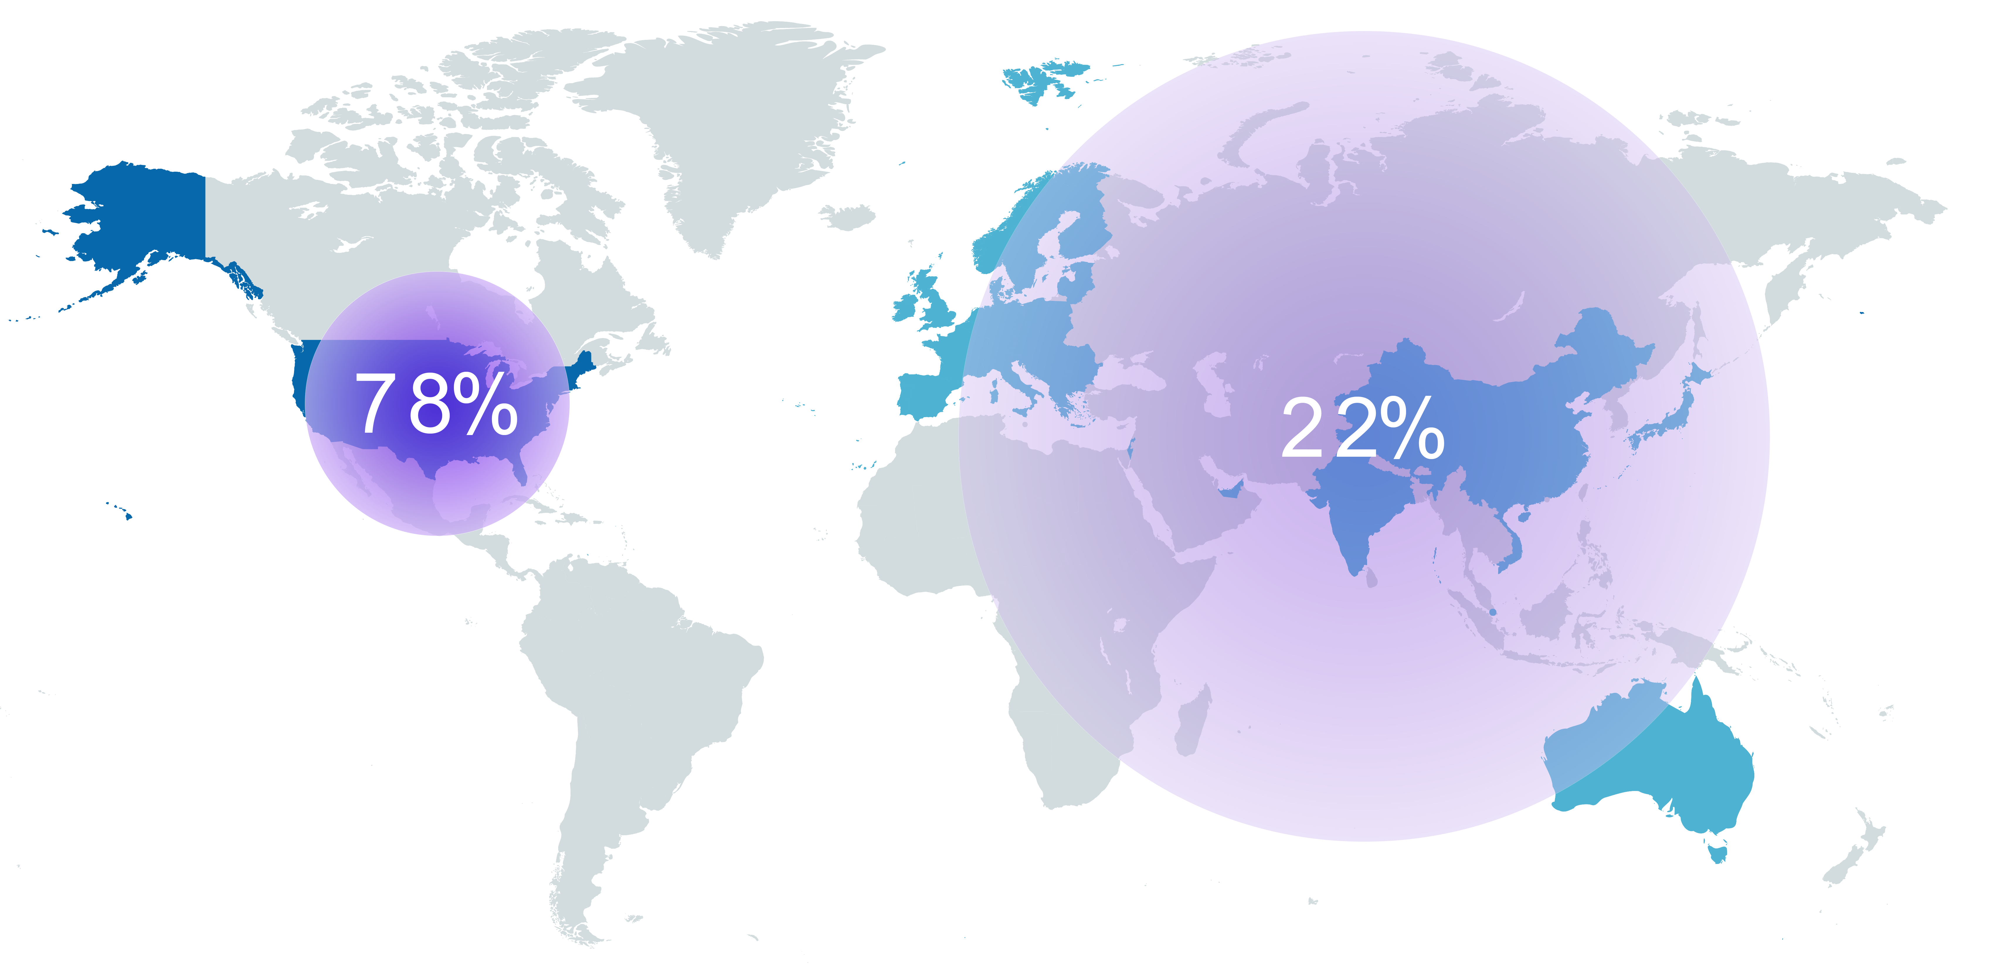
Geographic Distribution of Revenue

